Slide 1
Unit 1
Where’s Kitty?

Slide 2

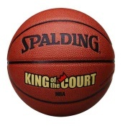


in
在……内(中)
Where is the basketball?
It’s in the box.

Slide 3
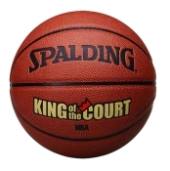
on
在……上面
指与物体表面接触
Where is the basketball?
It’s on the box.

Slide 4
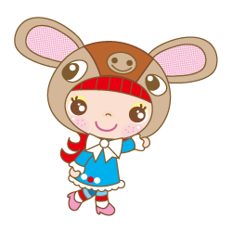
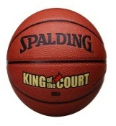

Where is the basketball?
It’s under the box.
under
在……下面（方）

Slide 5
In front of
在……前面（方）
Where is the basketball?
It’s in front of the box.

Slide 6
Behind
在……后面（方）
Where is the basketball?
It’s behind the box.

Slide 7

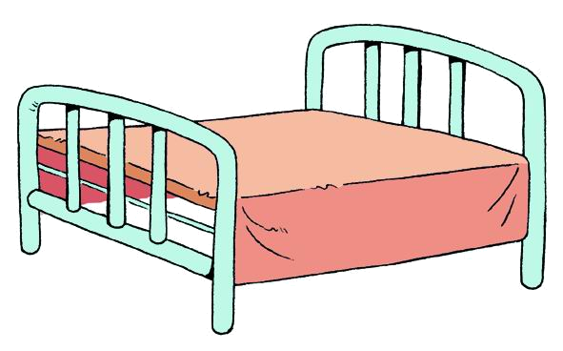
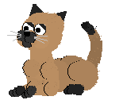

Where is the cat?
It is under the bed.
在……下面

Slide 8

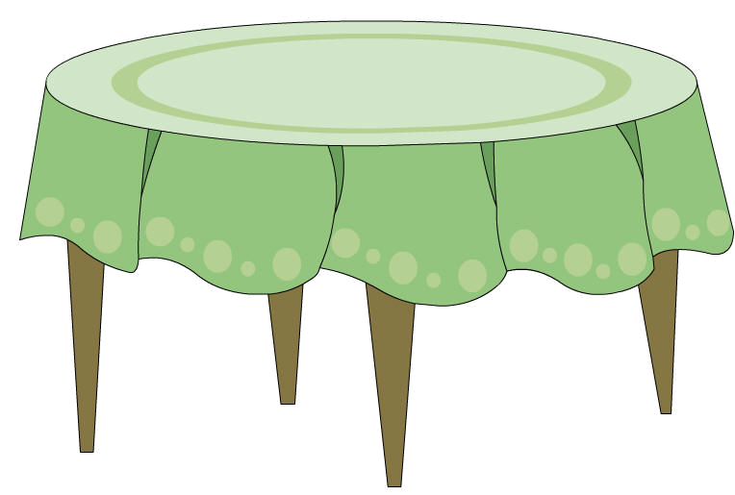
Where is the bird?
It is on the table.
在……上面

Slide 9



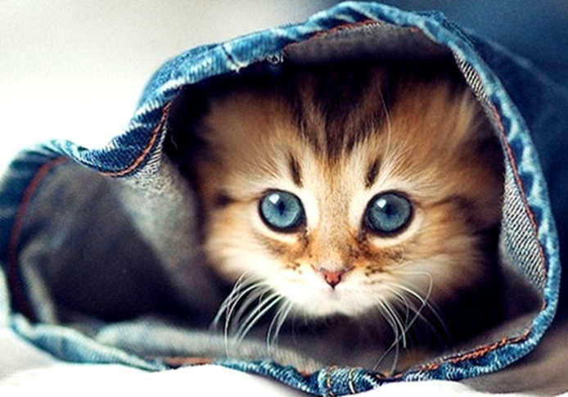
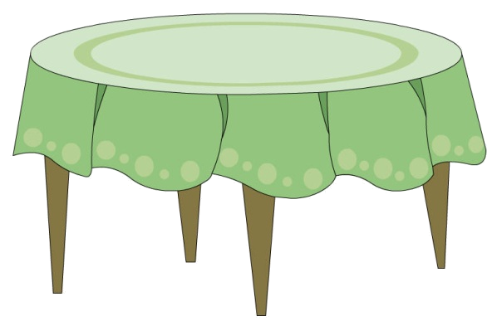
2
1
3
on
in
under
(在……上面）
（在……里面）
（在……下面）
Where is the cat? It is ___the table.
on
1
in
2
Where is the cat? It is ___ the bag.
under
Where is the cat? It is_______the bed.
3

Slide 10

Yes or No?
Let’s Judge.

Slide 11
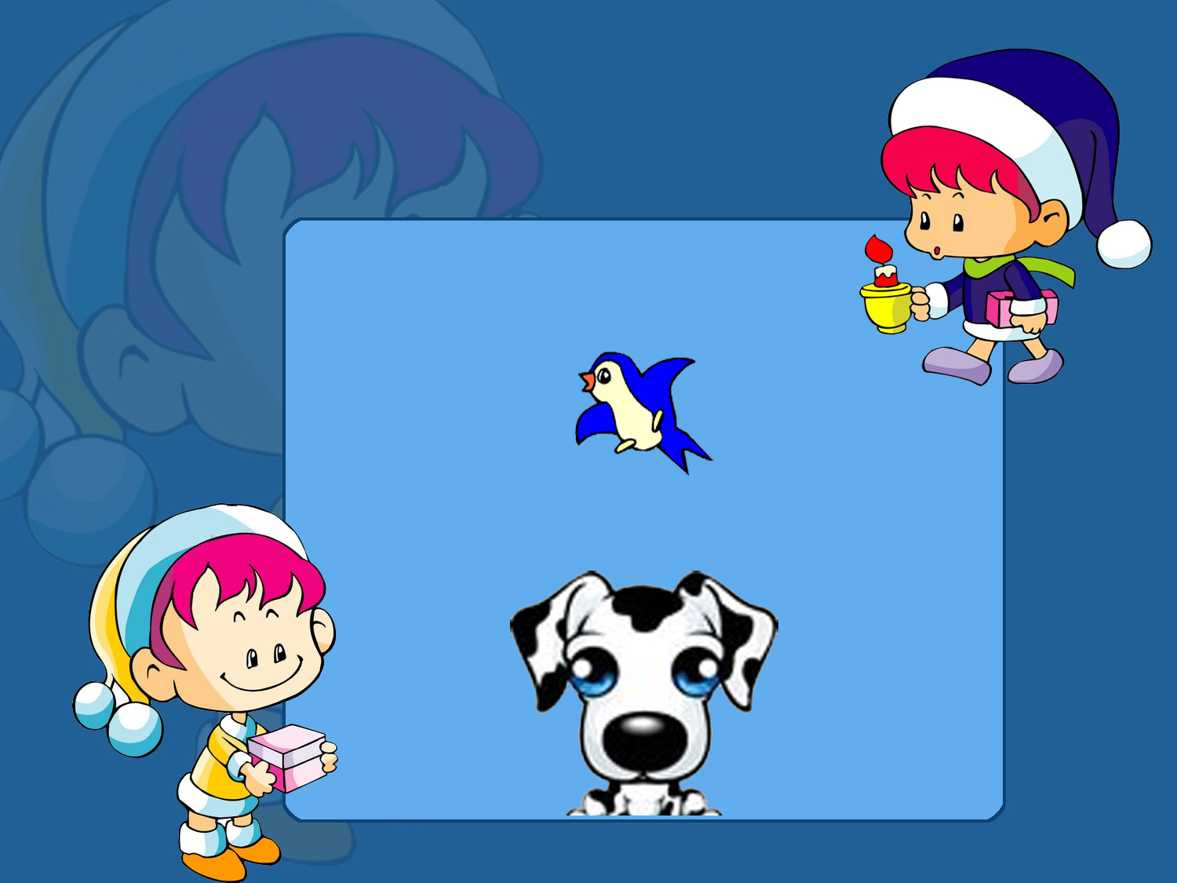
×
A bird is on the dog.( )

Slide 12
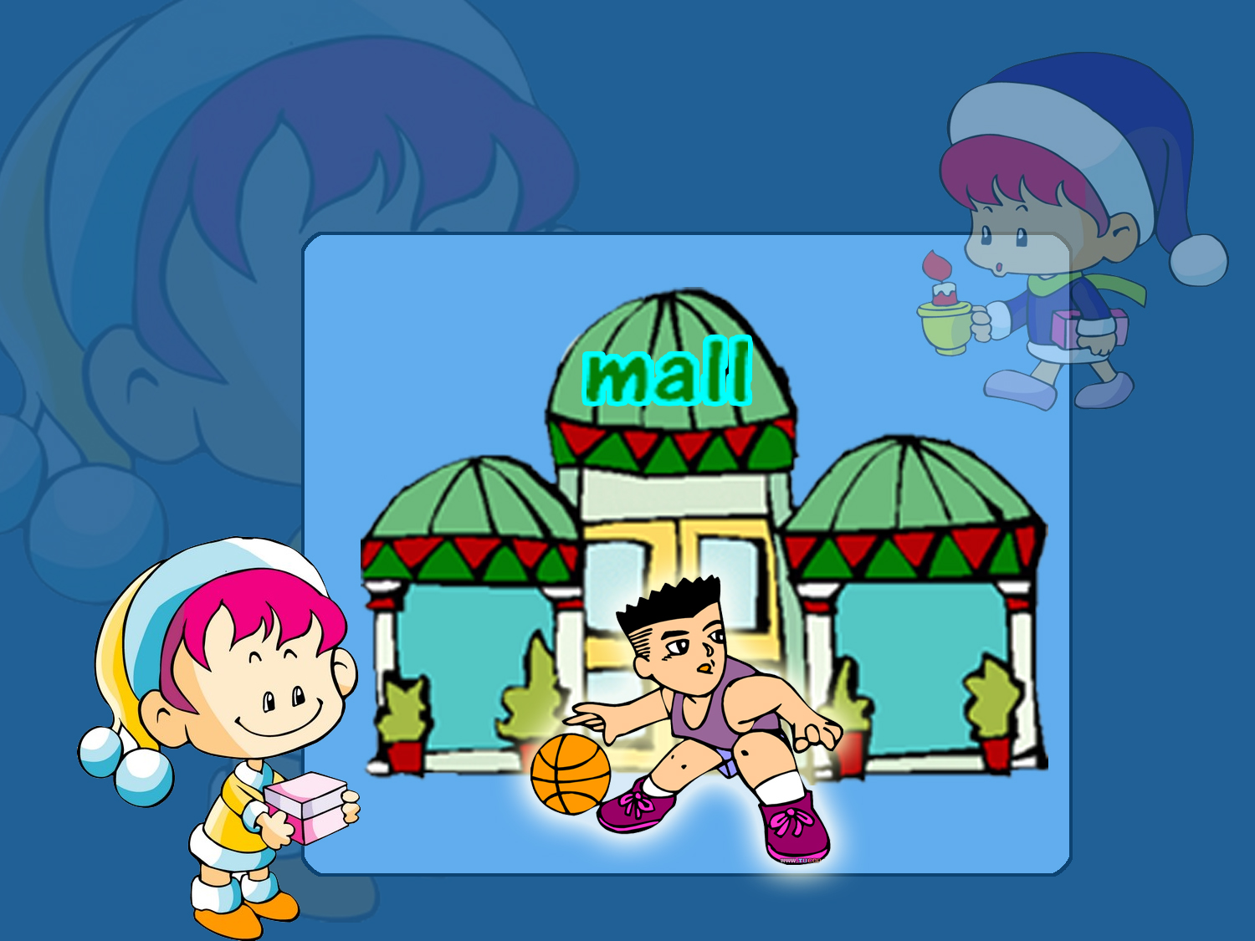
He is playing basketball in front of the mall.( )
√

Slide 13


